Slide 1


Hope to Skills
Lecture# 18
Irfan Malik, Dr. Sheraz Naseer

Slide 2
Agenda
Classification Techniques
Sci-kit Learn

Slide 3
Previous lecture:
Lecture 17 - Classification Using Scikit Learn
Click Here

Slide 4
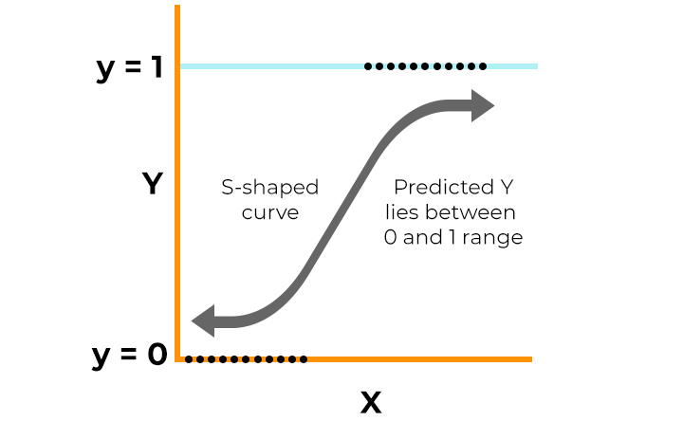
Logistic Regression
Logistic regression is a supervised machine learning algorithm that accomplishes binary classification tasks by predicting the probability of an outcome, event, or observation.

Slide 5
Different Classification Techniques

Slide 6
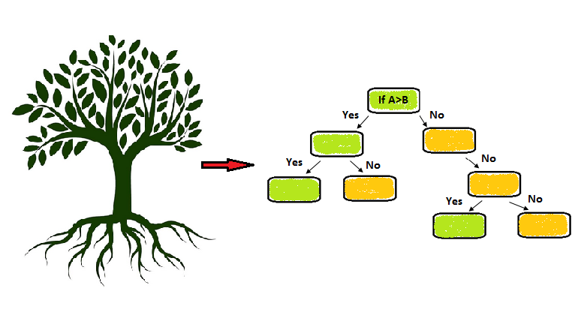
Decision Tree Classifier
A decision tree classifier makes decisions by splitting the data into smaller subsets based on the values of input features, ultimately assigning a class label to each data point. It constructs a tree-like structure of decision rules that can be used for prediction and is easy to interpret.

Slide 7
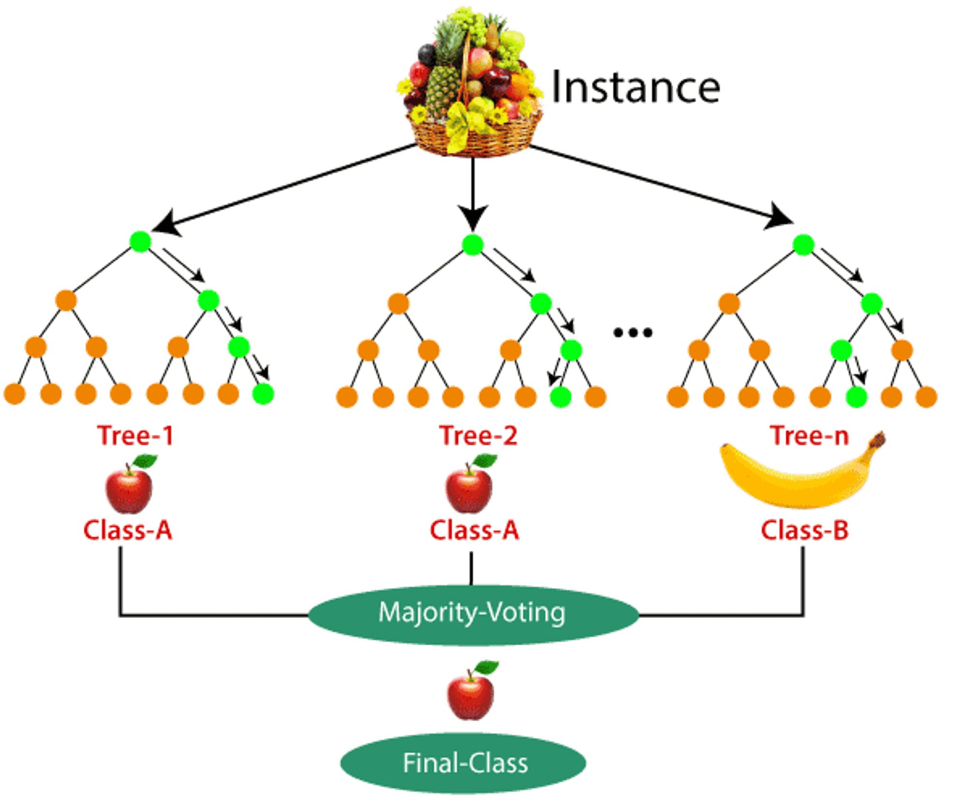
Random Forest Classifier
Random Forest is ensemble learning method that creates multiple decision trees during training and outputs the average prediction from all individual trees.

Slide 8
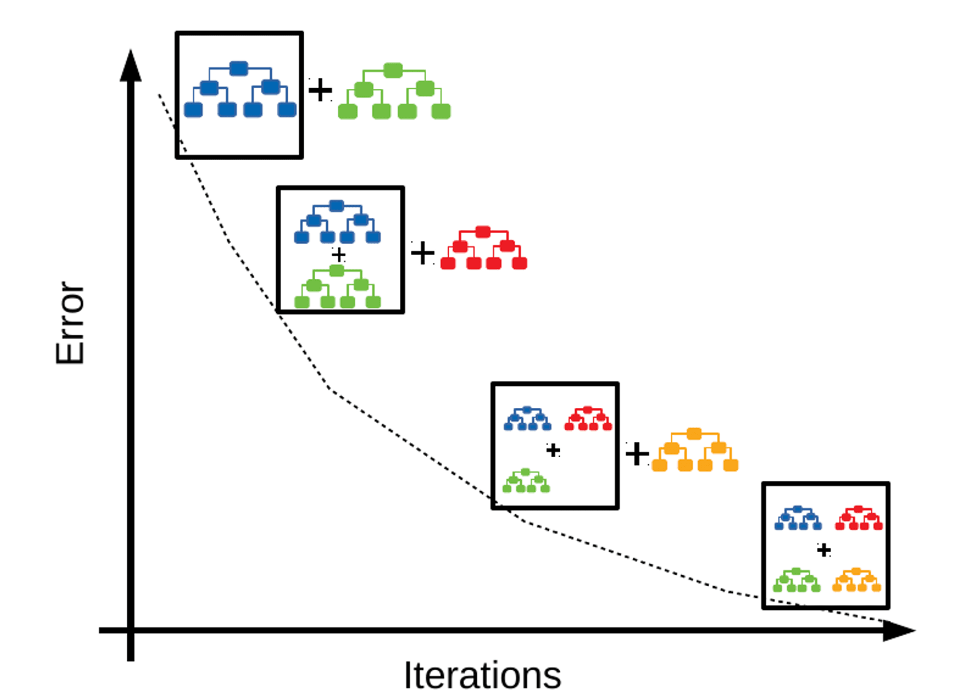
Gradient Boosting Classifier
Gradient Boosting Classifier is a powerful ensemble learning technique used for classification tasks. It belongs to the class of boosting algorithms, which build a strong predictive model by combining multiple weak learners sequentially.

Slide 9
Support Vector Machines (SVM):
Support Vector Machines (SVM) is a powerful supervised learning algorithm used for both classification and regression tasks.
Regression:
In regression tasks, SVMs aim to find the hyperplane that best fits the data while maintaining a maximum margin.
Classification:
In classification tasks, SVMs aim to find the hyperplane that best separates the data points of different classes in the feature space.

Slide 10
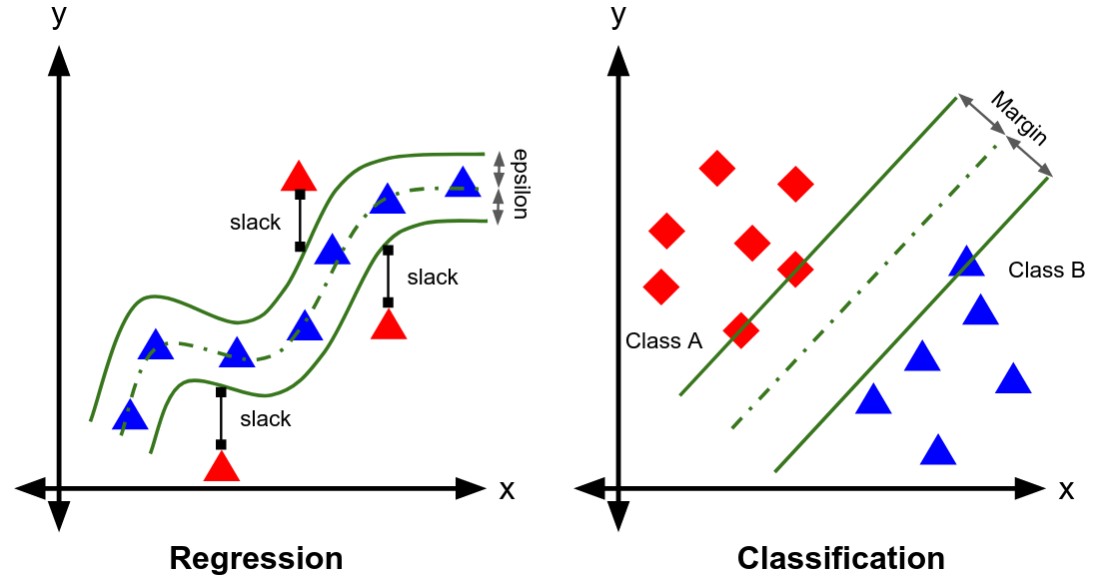

Slide 11
Ensemble:
Ensemble learning is a machine learning technique that combines the predictions of multiple individual models (learners) to improve overall performance and generalization. Instead of relying on a single model, ensemble methods create a "committee" of models and aggregate their predictions to make a final decision.

Slide 12
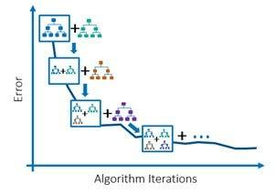
Gradient Boosting classifier
Gradient Boosting is ensemble learning technique that builds multiple decision trees sequentially, each one correcting the errors of its predecessor.

Slide 13

Accuracy
It is the ratio of number of correct predictions to the total number of input samples.
Note:It works well only if there are equal number of samples belonging to each class.

Slide 14
Self-learning Assignment
Gini index
Entropy
Sampling with replacement
Information gain
Assignment

Slide 15
Quiz
https://forms.gle/Rcqi5VuY1wEqf1w48

Slide 16
Next Lecture:
Lecture 19 - Regression
Click Here

